Slide 1
System Design

Slide 2
Analysis and Design
Analysis
  do the right thing
  (What exactly we want to do? We should be clear about that)
Design
  Do the thing right
  (Whatever we want to do, we should do that correctly)

Slide 3
Analysis
Analysis is a broad term. In Software development, we are primarily concerned with two forms of analysis.
Requirements Analysis is discovering the requirements that a system must meet, in order to be successful.
System (Process/Object/Module) Analysis is investigating the process/object in a domain to discover the information which is important to meet the requirements.

Slide 4
Design
Design emphasizes a conceptual solution that fulfills the requirements.
A design is not an implementation, although a good design can be implemented very easily when it is complete.
There are subsets of design, including architectural design, object/module design, and database design.

Slide 5
Overview of Design
A meaningful engineering representation of something that is to be built.
A design is a solution to a problem that is independent of any particular implementation (i.e. any specific language).
Why is it important? A house would never be built without a blueprint. Why should software? Without design the system may fail with small changes, is difficult to test and cannot be assessed for quality.
What is the work product? A design specification document.
Design is difficult because design is an abstraction of the solution which has not yet been created/implemented.

Slide 6
Structured design
OO design
SOA (service oriented architecture)
MDA (Model driven architecture)

Slide 7

Design Phase
SRS
DESIGN
S/W Design Doc (SDD)
Analysis
Repository
Design
Repository

Slide 8
Design Model
Component
Level Design
STD &
CSPEC
PSPEC
Interface
Design
DFD
Architectural
Design
Data
Dictionary
ERD
Data Design

Slide 9
Items Designed During Design Phase
module structure,
control relationship among the modules
  call relationship or invocation relationship
interface among different modules,
  data items exchanged among different modules,
data structures of individual modules,
algorithms for individual modules.

Slide 10
Definition
The practice of taking a specification of externally observable behavior and adding details needed for actual computer system implementation, including human interaction, task/function management, and data management details.
Coad and Yourdon (1991)

Slide 11
Definition
... a process of inventing and selecting modules that meet the objectives for a software system. Input includes an understanding of the following:
1. Requirements.
2. Any constraints.
3. Design criteria.
Stevens (1991)

Slide 12
The output of the design effort is composed of the following:
An architectural design, which shows how components/pieces are interrelated.
Module design is translated from information flow model (DFD).
Interface design: SW communicating within itself, with incorporated systems and with users.
Component design: Structural elements of SW architecture into procedural description of software components (algorithm).

Slide 13
Broad Characteristics
A mechanism for translating the physical problem to its design representation.
A notation for representing functional components and their interfaces.
Heuristics for refinement and partitioning.
Guidelines for quality assessment.

Slide 14
Broad Characteristics (contd.)
Design activities are usually classified into two stages:
  preliminary (or high-level) design
  detailed design.
Meaning and scope of the two stages:
  vary considerably from one methodology to another.

Slide 15
High-level design
Identify:
  modules
  control relationships among modules
  interfaces among modules.
d1
d2
d3
d1
d4

Slide 16
High-level design
The outcome of high-level design:
  program structure (or software architecture).

Slide 17
Detailed design
For each module, design:
  Data-structure
  algorithms
Outcome of detailed design:
  Module/process specification.

Slide 18
System architecture
Business Functions
(requirements, SRS)
System Processes
(design, Structure chart)
F
P
SF
SF
SF
SP
SP
EF
EF
EP
EP
EP

Slide 19
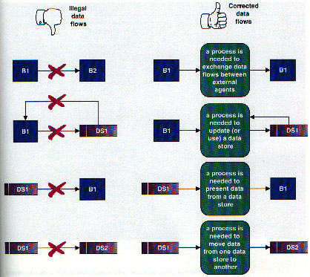
Illegal Data Flows in DFD

Slide 20
The Data Dictionary
The data dictionary is an organized listing of all data elements pertinent to the system with precise rigorous definitions so that both user and SA will have common understanding of all data elements.
It describes:
  meaning and composition of data flows,
  data stores
  relevant values and units of elementary data elements
  details of relationships between stores that are highlighted in a ERD

Slide 21
D D…
= is composed of
+ and
[ | ] either / or
{} repetition of (string)
() optional data
*---* for comments

Slide 22
Data Dictionary Notation
Example:
customer-name = title + first-name +
(middle-name) + last-name
title = [Mr. | Miss | Ms. | Mrs.| Dr. | Prof. ]
first-name = {legal-character}
order = customer-name + shipping-addr
+ {item}

Slide 23
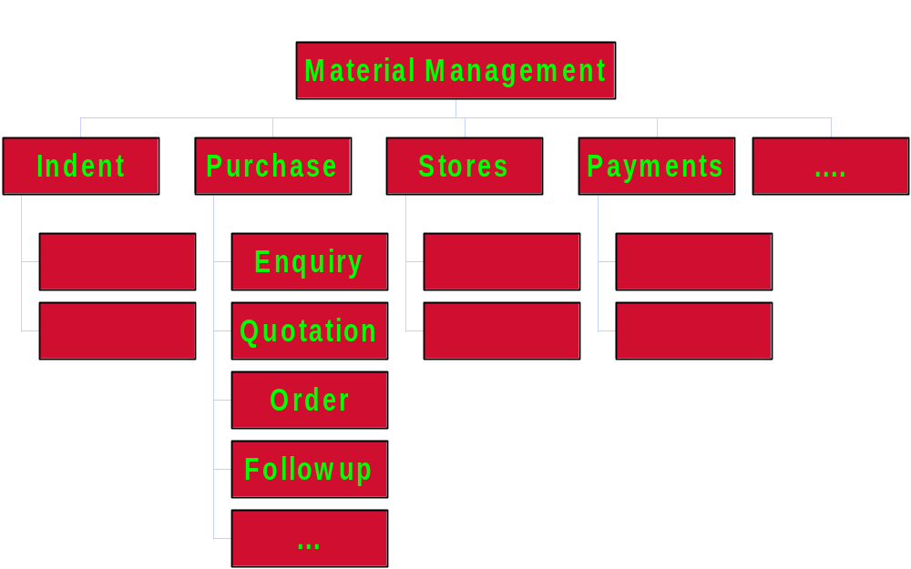
Business Functions

Slide 24
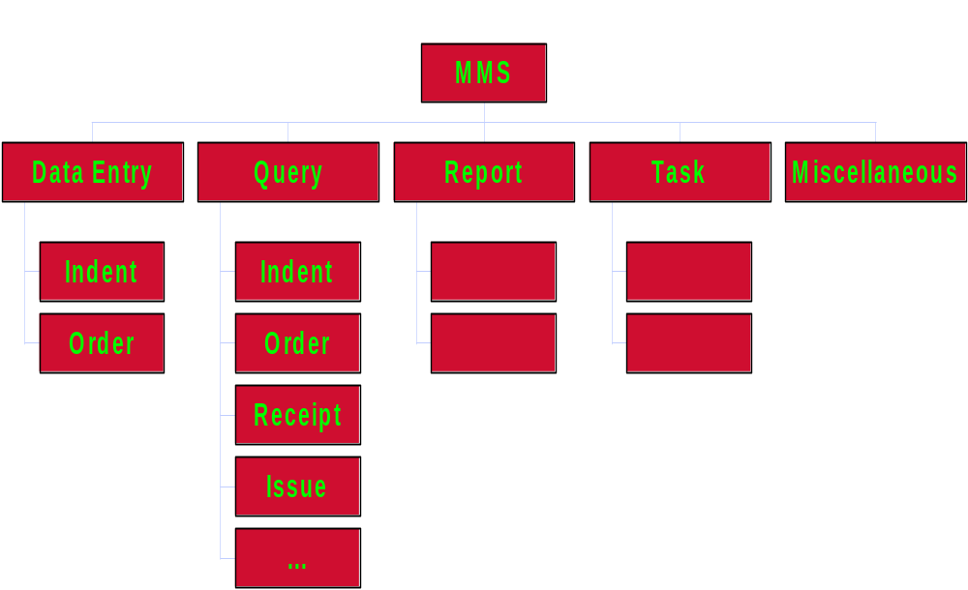
System Processes

Slide 25
Fundamental Concepts
Stepwise Refinement
Abstraction
Software Architecture
Program Structure
Data Structure
Modularity
Software Procedure
Information Hiding

Slide 26
Stepwise Refinement
Stepwise refinement is a top-down approach where a system is refined as a hierarchy of increasing levels of detail.
This process may be begun during requirements analysis and conclude when the detail of the design is sufficient for conversion into code. Processing procedures and data structures are likely to be refined in parallel.

Slide 27
Abstraction
Abstraction is a means of describing a program function, at an appropriate level of detail.
Highest level of abstraction - requirements analysis.
Lowest level of abstraction – implementation/programming.

Slide 28
Abstraction and Refinement
Abstraction:
  “Abstraction permits one to concentrate on a problem at some level of generalization without regard to irrelevant low level details..”
  Software Engineering is a process of refining the abstractions
  Modern programming languages allow for abstraction, e.g. abstract data types
  Types: data, procedural and control
Stepwise refinement
  gradual top-down elaboration of detail
  Abstraction and refinement are complementary. Abstraction suppresses low-level detail while refinement gradually reveals it.

Slide 29
Characteristics of Abstraction
Which type of details should be included and which should be excluded? (Example, should the model include structural or behavioral / static or dynamic details?)
Independent of type, how much detail should be included? What is the purpose of the abstraction? The purpose of the abstraction will dictate the type and amount of detail to include.

Slide 30
Data Abstraction
door
A named collection of data that describes a data object (may be a noun)
manufacturer
model number
type
swing direction
inserts
lights
type
number
weight
opening mechanism
implemented as a data structure

Slide 31
Procedural Abstraction
open
A named sequence of instructions with a specific and limited function (may be a verb)
details of enter
algorithm
implemented with a "knowledge" of the
object that is associated with enter

Slide 32
Abstraction
Definition:
Abstraction = process of separating inherent
properties or qualities of something from the
actual physical representation.
Procedural Abstraction
  separate what a procedure does from how it is done.
Data Abstraction
  describe what information is stored, not how.
  logical view instead of physical view.

Slide 33
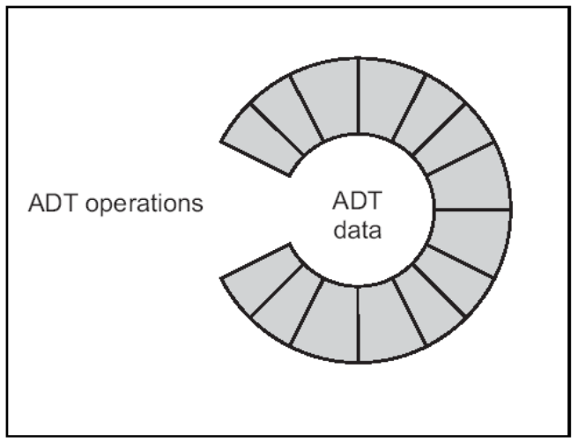
Abstraction
Leads to Information Hiding:
Abstract data types are only defined by their
methods, the actual implementation is hidden.
Advantage:
separation of definition and
implementation
Maintenance simplification
Data protected by methods

Slide 34
Stepwise Refinement
open
Process of elaboration, that decomposes a high-level statement of function until low-level programming language statements are reached
walk to door;
reach for knob;
repeat until door opens
open door;
turn knob clockwise;
if knob doesn't turn, then
walk through;
take key out;
close door.
find correct key;
insert in lock;
endif
pull/push door
move out of way;
end repeat

Slide 35
Software Architecture
While refinement is about the level of detail, architecture is about structure. The architecture of the procedural and data elements of a design represents a software solution for the real-world problem defined by the requirements analysis.

Slide 36
Program Structure
The program structure represents the hierarchy of control. Program structure is usually expressed as a simple hierarchy showing super-ordinate and subordinate relationships of modules.

Slide 37
Control Hierarchy
Width
M
a
b
c
Depth
d
e
f
g
h
i
j
k

Slide 38
Data Structure
Data structure dictates the organization, access methods, degree of associativity, and processing alternatives for problem-related information. Classic data structures include scalar, sequential, linked-list, n-dimensional, and hierarchical. Data structure, along with program structure, makes up the software architecture.

Slide 39
Modularity
Modularity derives from the architecture.
Modularity is a logical partitioning of the software design that allows complex software to be manageable for purposes of implementation and maintenance.
The logic of partitioning is based on related functions, implementation considerations, data links, or other criteria.
Modularity does imply interface overhead related to information exchange between modules and execution of modules.

Slide 40
Benefits of Modularity
Easier to build; easier to change and easier to fix the errors.
“Modularity is the single attribute of software that allows a program to be intellectually manageable”.
Don’t overdo it. Too many modules makes integration complicated.
Sometimes the code may be monolithic (e.g. real-time and embedded software) but the design still shouldn’t be.
Effective modular design is achieved by developing “single minded” (highly cohesive) modules with a “dislike” to excessive interaction (low coupling).

Slide 41
Management: Partition the overall development effort – Divide and conquer (easy to manage)
• Evolution: Decouple parts of a system so that changes to one part are isolated from changes to other parts (other modules can be added easily).
– Principle of directness (clear allocation of requirements to modules, ideally one requirement (or more) maps to one module)
– Principle of continuity/locality (small change in requirements triggers a change to one module only)
• Understanding: Permit system to be understood easily.

Slide 42
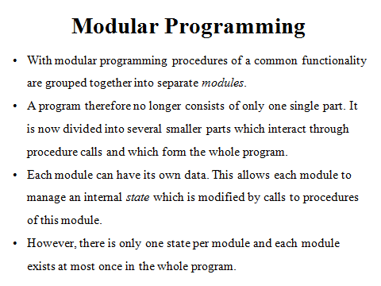

Slide 43
Modularity: Trade-offs
What is the "right" number of modules for a specific software design ?
module development cost
cost of
software
module
integration
cost
optimal number
number of modules
of modules

Slide 44
Modularity
p1,p2…pN be the processes
C(p1) > C(p2) ➔ E(p1) > E(p2)
C(p1+p2) > C(p1)+C(p2) ➔ E(p1+p2) > E(p1)+E(p2) (C-complexity, E-efforts)
  Modular Decomposability
  Modular Composability
  Modular understandability
  Modular continuity
  Modular protection
  Modular testability

Slide 45
Modularity Support
Design method supports effective modularity if it evidences:
  Decomposability - a systematic mechanism for decomposing the problem
  Composability - able to reuse modules in a new system
  Understandability - the module can be understood as a standalone unit
  Continuity - minimizes change-induced side effects
  Protection - minimizes error-induced side effects
  Testability – how easily can we test the components and
  the whole system

Slide 46
Example of Cleanly and Non-cleanly Decomposed Modules

Slide 47
Modularity
In technical terms, modules should display:
  high cohesion
  low coupling.
We must understand
  cohesion and coupling.

Slide 48
Modularity
Neat arrangement of modules in a hierarchy means:
  low fan-out and abstraction

Slide 49
Cohesion and Coupling
Cohesion is a measure of:
  functional strength of a module.
  A cohesive module performs a single task or function.
Coupling between two modules:
  a measure of the degree of interdependence or interaction between the two modules.

Slide 50
Cohesion and Coupling
A module having high cohesion and low coupling:
  functionally independent of other modules:
    A functionally independent module has minimal interaction with other modules.

Slide 51
Coupling…
High coupling
Low coupling

Slide 52
Coupling: Degree of inter-dependence among components
No dependencies
Loosely coupled-some dependencies
High coupling makes modification of parts of the system very difficult, e.g., modifying a component affects all the components to which the component is connected.
Highly coupled-many dependencies

Slide 53
Advantages of Functional Independence
Better understandability and good design:
Complexity of design is reduced,
Different modules easily understood in isolation:
  modules are independent

Slide 54
Advantages of Functional Independence…
Functional independence reduces error propagation.
  degree of interaction between modules is low.
  an error existing in one module does not directly affect other modules.
Reuse of modules is possible.

Slide 55
Advantages of Functional Independence…
A functionally independent module:
  can be easily taken out and reused in a different program.
    each module does some well-defined and precise function
    the interfaces of a module with other modules are simple and minimal.

Slide 56
Continue…
Unfortunately, there are no ways:
  to quantitatively measure the degree of cohesion and coupling:
  classification of different kinds of cohesion and coupling will give us some idea (based on research conducted in the area of software engineering) regarding the degree of cohesiveness of a module.

Slide 57
Classification of Cohesiveness
Classification is often subjective:
  yet gives us some idea about cohesiveness of a module.
By examining the type of cohesion exhibited by a module:
  we can roughly tell whether it displays high cohesion or low cohesion.

Slide 58
Classification of Cohesiveness
functional
sequential
communicational
Degree of
cohesion
procedural
temporal
logical
coincidental

Slide 59
Coincidental cohesion
The module performs a set of tasks:
  which relate to each other very loosely, if at all.
    the module contains a random collection of functions.
    functions have been put in the module out of pure coincidence without any thought or design.
    module performs multiple, unrelated actions
  – This amounts to arbitrary modularization

Slide 60
The result of randomly breaking the project into modules to gain the benefits of having multiple smaller modules to work on-
- Inflexible enforcement of rules such as: “every function/sub-module shall be between 40 and 80 lines in length” can result in coincidental cohesion.
- Usually worse than no modularization and may often confuses the reader

Slide 61
Logical cohesion
All elements of the module perform similar or related actions/operations:
  e.g. error handling, data input, data output, etc.
An example of logical cohesion:
  a set of print functions to generate an output report arranged into a single module.

Slide 62
Temporal cohesion
The module contains tasks that are related by the fact:
  all the tasks must be executed in the same time span.
Example:
  The set of functions responsible for
    all system initialization actions
    start-up, shut-down of some process, etc.

Slide 63
Example
A system initialization module:
this module contains all of the code for initializing all of the parts of the system. Lots of different activities occur, all at initialization time.
Improvement
A system initialization routine sends an initialization message to each component of the system.
Each component initializes itself at component instantiation time.
Notes:
I don’t even want to think about it.

Slide 64
Procedural cohesion
The set of functions of the module:
  all are part of a procedure (algorithm)
  certain sequence of steps have to be carried out in a certain order for achieving an objective, module performs a set of weakly-connected actions corresponding to the sequence of steps in some operation.
  – E.g.-
  - all of the operations involved in an ATM
  transaction,
  - the algorithm for decoding a message.

Slide 65
Communicational cohesion
All functions of the module:
  reference or update the same data structure, or which operate on the same data.
  Example:
  the set of functions defined on an array or a stack.
  Update a database, record update to audit trail, print the update etc.

Slide 66
Sequential cohesion
Elements of a module form different parts of a sequence,
  output from one element of the sequence is input to the next.
  Example:
sort
search
display

Slide 67
Functional cohesion
Different elements of a module cooperate:
  to achieve a single function.
  e.g. managing an employee's pay-roll.
  - calculate sales commission.
When a module displays functional cohesion,
  we can describe the function using a single sentence.

Slide 68
Determining Cohesiveness
Write down a sentence to describe the function of the module
  If the sentence is compound,
    it has a sequential or communicational cohesion.
  If it has words like “first”, “next”, “after”, “then”, etc.
    it has sequential or temporal cohesion.
  If it has words like initialize,
    it probably has temporal cohesion.

Slide 69
Coupling
Coupling indicates:
  how closely two modules interact or how interdependent they are.
  The degree of coupling between two modules depends on their interface complexity.

Slide 70
Coupling
There are no ways to precisely determine coupling between two modules:
  classification of different types of coupling will help us to approximately estimate the degree of coupling between two modules.
Five types of coupling can exist between any two modules.

Slide 71
Classes of coupling
data
stamp
Degree of
coupling
control
common
content

Slide 72
Data coupling
Two modules are data coupled,
  if they communicate via a parameter:
    an elementary data item is passed as a parameter,
    e.g an integer, a float, a character etc.
  The data item should be problem related:
    not used for control purpose.

Slide 73
Stamp coupling
Two modules are stamp coupled,
  if they communicate via a composite data item
    such as a record in PASCAL
    or a structure in C.

Slide 74
Control coupling
Data from one module is used to direct
  order of instruction execution in another.
Example of control coupling:
  a flag set in one module and tested in another module.

Slide 75
Common Coupling
Two modules are common coupled,
  if they share some global data.

Slide 76
Content coupling
Content coupling exists between two modules:
  if they share code,
  e.g, branching from one module into another module.
The degree of coupling increases
  from data coupling to content coupling.

Slide 77
Content coupling - When a module can directly access or modify or refer to the content of another module, it is called content level coupling.
When a module uses/alters data in another module.
Common coupling- When multiple modules have read and write access to some global data, it is called common or global coupling.
Control coupling- Two modules are called control-coupled if one of them decides the function of the other module or changes its flow of execution.
Stamp coupling- When multiple modules share common data structure and work on different part of it, it is called stamp coupling.
Data coupling- Data coupling is when two modules interact with each other by means of passing data (as parameter). If a module passes data structure as parameter, then the receiving module should use all its components.

Slide 78
Data Coupling
Modules communicate by parameters,
Each parameter is an elementary piece of data,
Each parameter is necessary to the communication and Nothing extra is needed.
Data coupling problems
Too many parameters - makes the interface difficult to understand and possible error to occur
Tramp data - data ‘traveling’ across modules before being used
Stamp coupling
A composite data is passed between modules,
Control coupling
A module controls the logic of another module through the parameter
Controlling module needs to know how the other module works - not flexible!
Common coupling
Use of global data as communication between modules
Danger of ripple effect
Content coupling
A module refers to the inside of another module
Branch into another module
Refers to data within another module
Changes the internal workings of another module
Mostly by low-level languages

Slide 79
Neat Hierarchy
Control hierarchy represents:
  organization of modules.
Most common notation:
  a tree-like diagram called structure chart.

Slide 80
Characteristics of Module Structure
Depth:
  number of levels of control
Width:
  overall span of control.
Fan-out:
  a measure of the number of modules directly controlled by given module.

Slide 81
Control Hierarchy
Width
M
a
b
c
Depth
d
e
f
g
h
i
j
k

Slide 82
Characteristics of Module Structure
Fan-in:
  indicates how many modules directly invoke a given module.

Slide 83
Module Structure
Fan out=2
Fan out=1
Fan in=1
Fan in=2
Fan out=0

Slide 84
Software Procedure
Software procedure provides a precise specification of the software processing, including sequence of events, exact decision points, repetitive operations, and data organization. Processing defined for each module must include references to all subordinate modules identified by the architecture/ structure.

Slide 85
Information Hiding
Information hiding is an adjunct of modularity. It permits modules to be designed and coded without concern for the internals of other modules. Only the access protocols of a module need to be shared with the implementers of other modules. Information hiding simplifies testing and modification by localizing these activities to individual modules.

Slide 86
Benefits of Information Hiding
A more accurate term would be “details hiding”
E.g. Supported by public and private specifiers in C++, Java
Benefits of Information Hiding:
  Leads to low coupling
  Reduces the likelihood of “side effects”
  Limits the global impact of local design decisions
  Emphasizes communication through controlled interfaces
  Discourages the use of global data
  Results in higher quality software

Slide 87
Summary of Design Concepts
Abstraction: Enables a problem to be addressed at a high-level of generalization without worrying about low-level details.
Refinement: Process of gradual top-down elaboration of detail.
Abstraction and refinement are complementary.
Modularity: Software subdivided into separately named and addressable components.
Coupling: The degree to which a module is connected to other modules in the system.
Cohesion: The degree to which a module performs one and only one function.
Information Hiding: Portions of the internal structure of a component are hidden and inaccessible from outside.

